Slide 1

Program Evaluation Essentials
Evaluation Support 2.0
Session 3
Anita M. Baker, Ed.D. Evaluation Services
Bruner Foundation
Rochester, New York

Slide 2
Evaluation Support 2.0
Sponsored by the Bruner Foundation www.evaluativethinking.org and Evaluation Services www.evaluationservices.co
Free evaluation training and technical assistance focused on development of evaluative capacity including data analysis and reporting.
Four (4), on-site, hands-on training sessions.
Introduction to and use of free/low-cost tools to facilitate data entry, management and analysis.
Guided evaluation project required.
Virtual conference with funder, other organization participants.
Bruner Foundation
Rochester, New York

Slide 3
E-Surveys – Key Decisions
Why use an e-survey rather than a hard-copy survey/ intercept survey/ alternative survey or other data collection strategy?
What question types do you need?
  How will they be displayed?
  Do you need an “other” field?
  Should they be “required?”
Bruner Foundation
Rochester, New York

Slide 4
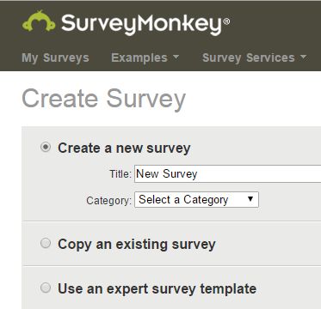
Before You Create an E-survey
Strong items
Administration plan
Analysis plan
Respondent experience

Slide 5
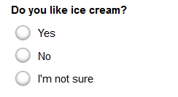
Multiple Choice (only 1 answer)
Forced Choice Item (MO)
Directions read: Mark One – unless it is so obvious that is the expectation.
Bruner Foundation
Rochester, New York

Slide 6
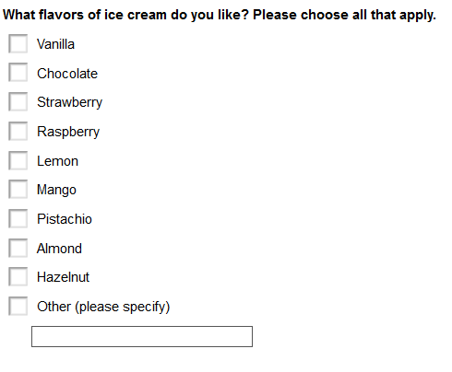
Multiple Choice (multiple answers)
Multiple Response Item (MATA)
Multiple response items often create analysis challenges. Use sparingly.
Bruner Foundation
Rochester, New York

Slide 7
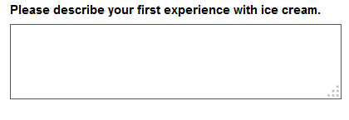
Comment/Essay Box/Open-ended
Bruner Foundation
Rochester, New York

Slide 8
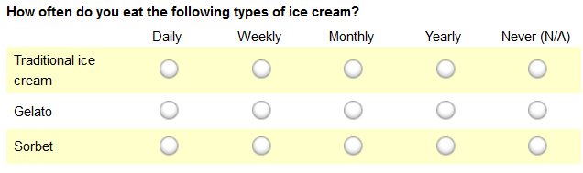
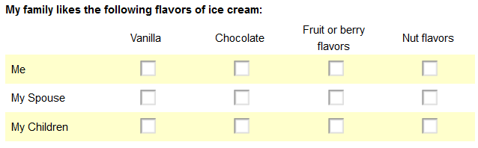
Matrix of Choices
(1 answer/row vs. multi answers/row)
Bruner Foundation
Rochester, New York

Slide 9
Likert/Rating Scale
 | Not at all important | Slightly important | Somewhat important | Moderately important | Extremely important
Quality of ingredients
Flavor
Texture
Brand
A true Likert scale has 5 answer choices, and by the way it is pronounced Lick –ert not Like –ert. (The strategy was named for Rensis Likert who invented or popularized them.)
Bruner Foundation
Rochester, New York

Slide 10

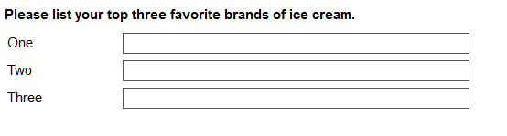
Single Vs. Multiple Textboxes
You must have an analysis plan for using these data.
Bruner Foundation
Rochester, New York

Slide 11
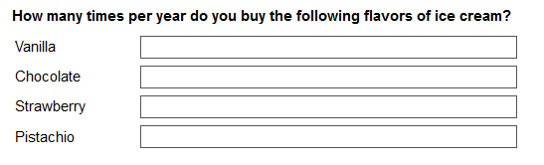
Numerical Textboxes
You must have an analysis plan for using these data. Consider hard codes (e.g., 1/month, at least 6 times per year, etc.) – and using single text boxes; or true numbers when they exist which can then be used in other calculations like averages.
Bruner Foundation
Rochester, New York

Slide 12
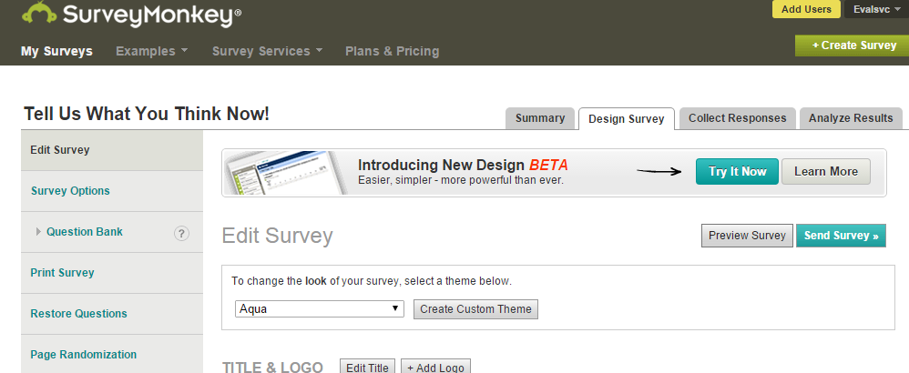
Printing a Survey
From the design survey menu select Print Survey

Slide 13
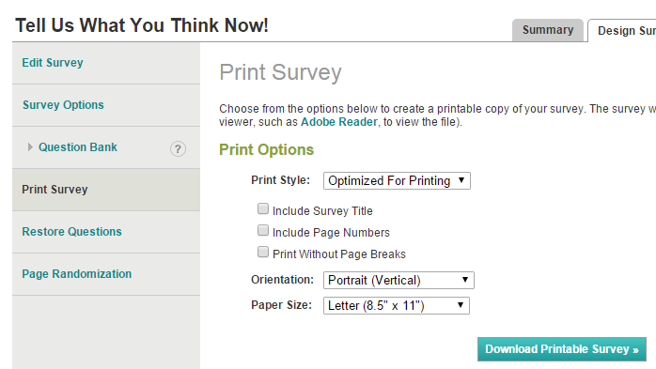
Printing Surveys
Then Click here
✓
✓
✓
This will generate a Survey in PDF format.

Slide 14
Evaluative
Thinking

Slide 15
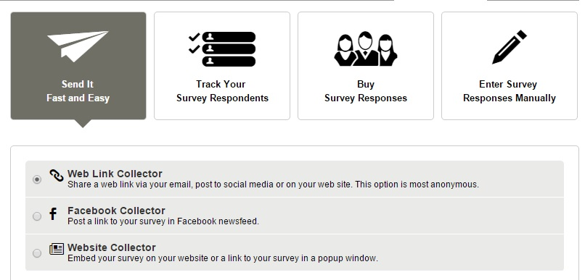
Survey Response Collector Types
  Types of collectors: Weblink; Email Tracker; Facebook/Website Post; Manual Data Entry*

Slide 16
Weblink Collector
Write your own cover email
Dear Colleague,
Recently you attended an Allied Against Violence training session provided by the Center for Anti-Violence Education and agreed to provide some follow-up feedback regarding your use of the materials and strategies. Please click on the following link to start the very brief follow-up survey. It should only take you a few minutes to respond and your answers will be kept confidential. All responses will be combined and summarized to inform CAE’s continued work in this field.
Thank you in advance for your assistance
CLICK HERE https://www.surveymonkey.com/s.aspx
Thank you pages (default or custom)

Slide 17
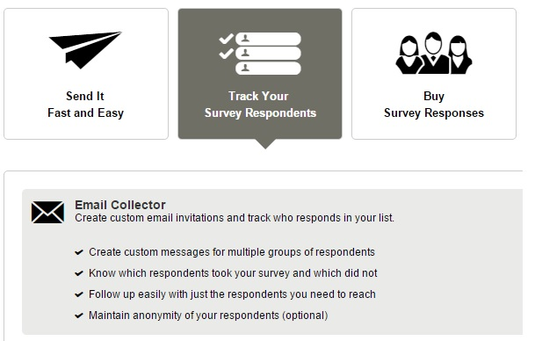
Follow-Up and Track Responses

Slide 18
Manual Data Entry: Two Strategies
  Data entry/use as a database
Weblink Collector: (Fast/Easy)
Advanced Settings:
Allow more than 1 respondent per computer
  Survey End Page: Loop to start

Slide 19
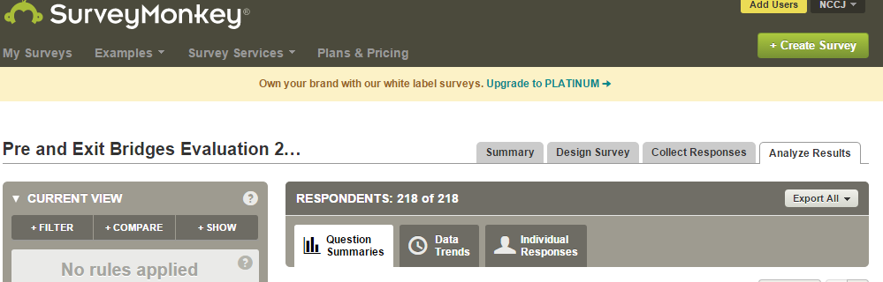
Analyzing Data Using Survey Monkey
Key Skills
Generating and using frequencies
Bruner Foundation
Rochester, New York

Slide 20
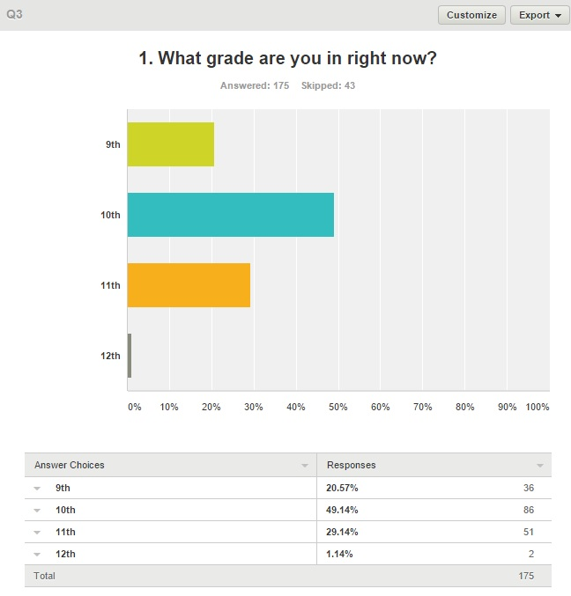
Analyzing Data Using Survey Monkey
Key Skills
Generating and customizing graphics
Exporting graphs and tables

Slide 21
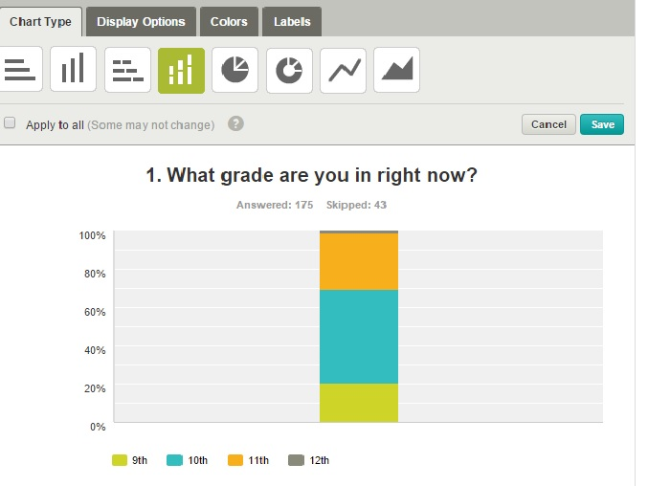

Slide 22
Analyzing Data Using Survey Monkey
Key Skills
Using Filters – allows you to select data, remove “missing data” and use numerical analysis functions.
Comparing data – calculates cross-tabs

Slide 23
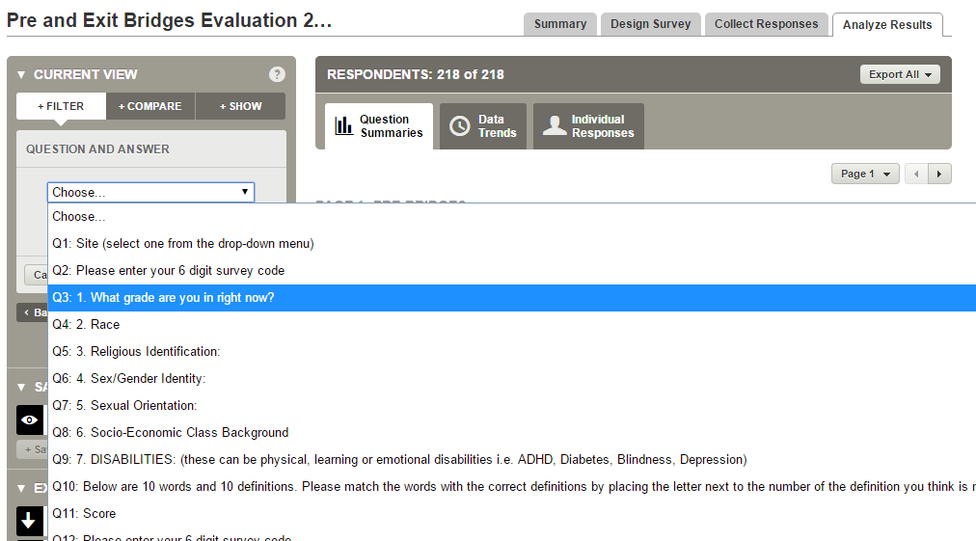
Analyzing Data Using Survey Monkey
Key Skills
Using Filters: Filter by Q&A

Slide 24
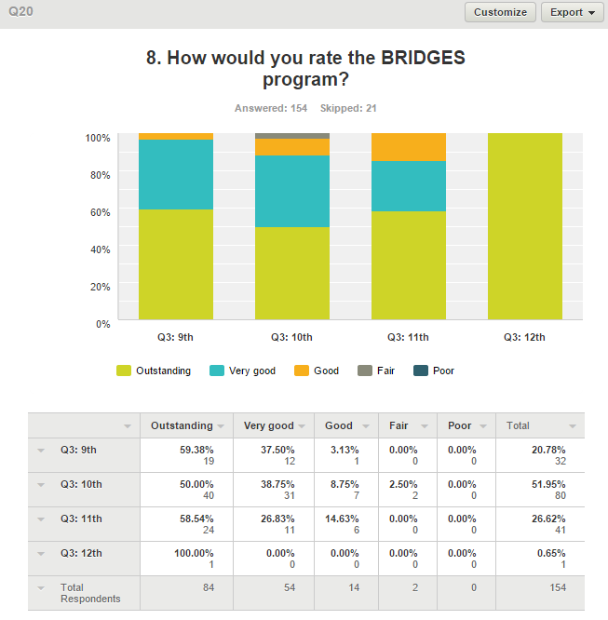
Using Compare

Slide 25
Compare/Cross-tab Considerations
Decide whether to use row or column percents to present your data. The calculations answer different questions.
  Do you want to know for each grade group how many rated the program positively (i.e., outstanding or very good)?
    OR
  Do you want to know what grade the positive respondents were in?
TIP: Pick a strategy and use it consistently.
Bruner Foundation
Rochester, New York

Slide 26
Analyzing Data Using SM
Exporting and Merging Data
Export All - All Summary Data
(PDF – which can be customized)
Export All - All Response Data
(Excel or SPSS, Zipped File - sheet 1 has data)
Merging Data – connecting data from a survey monkey file with other data using a common key
Bruner Foundation
Rochester, New York

Slide 27
Survey Result Example: Excel Summary
BEC Session 2 - January 2012
How would you rate Session 2 overall?
Answer Options | Response Percent | Response Count
Not So Good | 0 | 0
Okay | 15% | 5
Very Good | 71% | 24
Excellent | 15% | 5
answered question |  | 34
skipped question |  | 1
Bruner Foundation
Rochester, New York

Slide 28
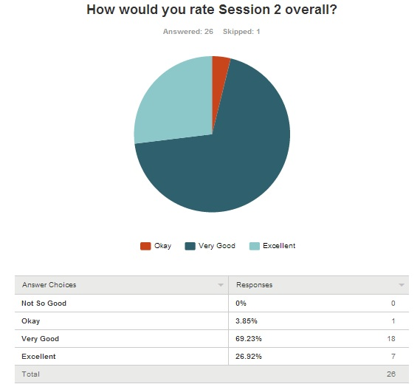
SURVEY RESULT EXAMPLE
Bruner Foundation
Rochester, New York

Slide 29
Evaluative
Thinking

Slide 30
Definitive Statements
Percent of Training Participants (N=93) who Think AAV Helped or Will Help Them:⬇ | Some | A Lot | TOTAL
Discuss issues of violence with clients | 45% | 55% | 100%
Access additional strategies for self-care/stress reduction | 47% | 51% | 98%
Provide positive interventions for clients | 32% | 65% | 97%
Understand the importance of self-care/stress reduction | 38% | 58% | 96%
Offer clients new ways to:
De-escalate Situations | 31% | 67% | 98%
Manage Anger | 54% | 43% | 97%
Do safety planning | 45% | 52% | 97%
Conduct Bystander Interventions | 39% | 58% | 97%
Target = 50% or more say “a lot” to each
AAV met its targets for all areas of interest except Management of Anger
More than 95% of participants thought AAV helped or will help them with each of the focus areas of the training.
Bruner Foundation
Rochester, New York

Slide 31
Definitive Statements
% of 2005-06 Freshman who . . . | Peer Study Group |  | Total
 | Yes n=212 | No n=257 | N=479
Reported struggling to maintain grades | 36% | 58% | 47%
Are planning to enroll for the sophomore year at this school | 89% | 73% | 80%
Only about 1/3 of freshman in peer study groups reported struggling to
maintain their grades compared to ½ of those not in study groups.
Proportionately more study group participants are planning to enroll for sophomore year.
Bruner Foundation
Rochester, New York

Slide 32
Survey Monkey Questions?
http://help.surveymonkey.com/

